Slide 1
othello_results/showcase_games__Lefty_black_vs_Corner Bot_white
showcase_games_6 Winner: Lefty Black

Slide 2
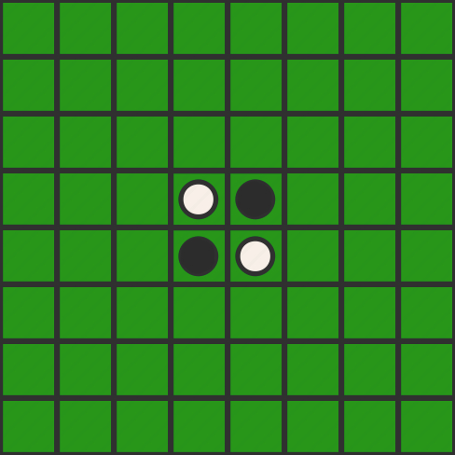
turn: 0 player: None move: None

Slide 3
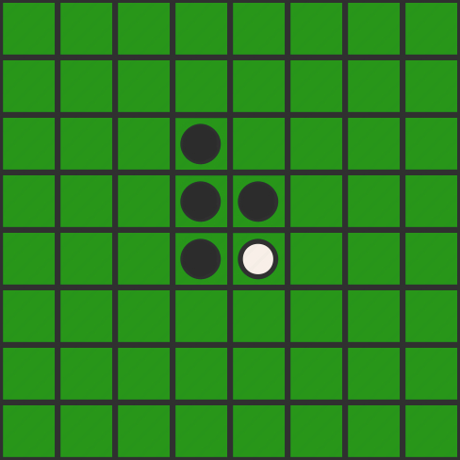
turn: 1 player: Black move: 34

Slide 4
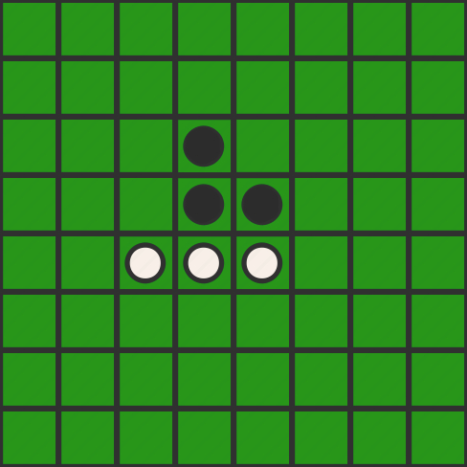
turn: 2 player: White move: 53

Slide 5
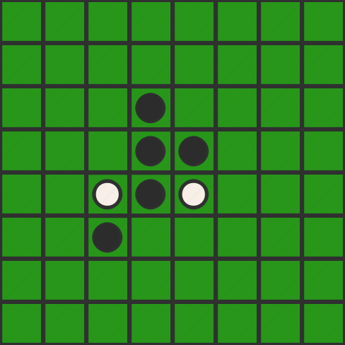
turn: 3 player: Black move: 63

Slide 6
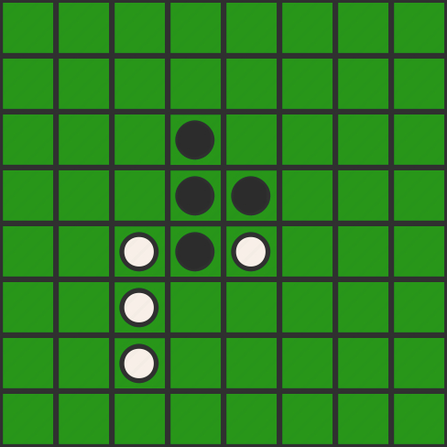
turn: 4 player: White move: 73

Slide 7
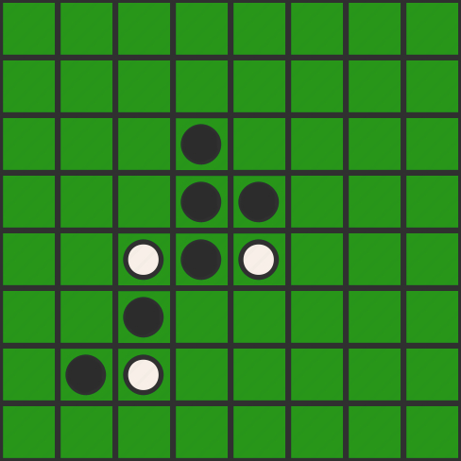
turn: 5 player: Black move: 72

Slide 8
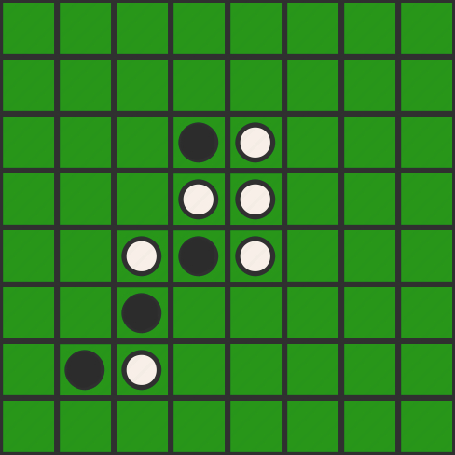
turn: 6 player: White move: 35

Slide 9
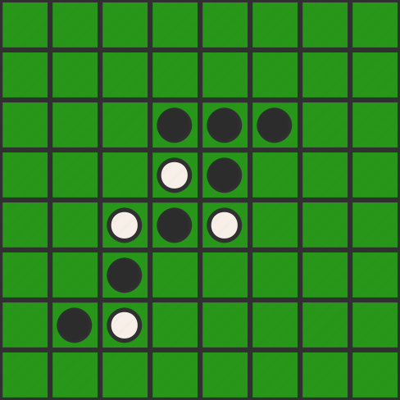
turn: 7 player: Black move: 36

Slide 10
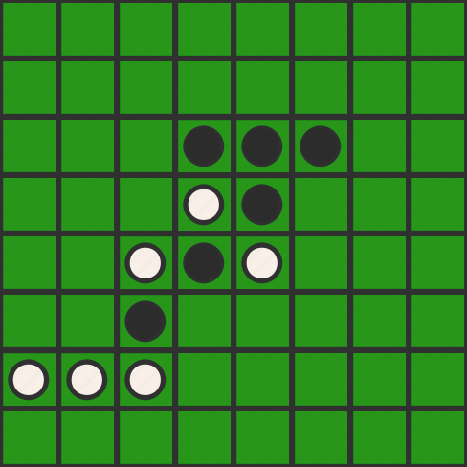
turn: 8 player: White move: 71

Slide 11
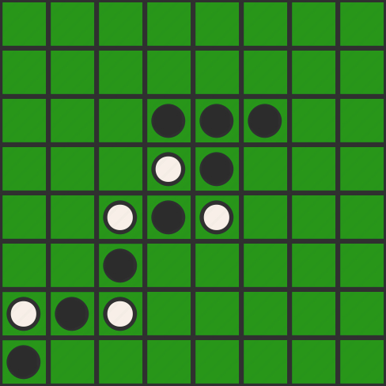
turn: 9 player: Black move: 81

Slide 12
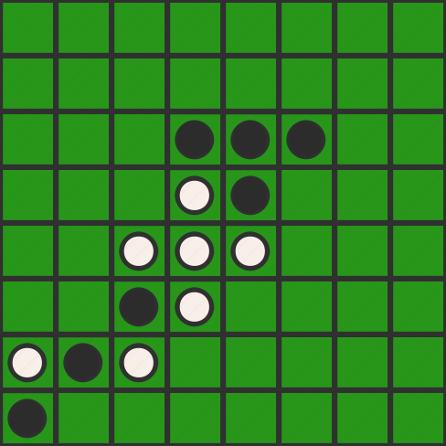
turn: 10 player: White move: 64

Slide 13
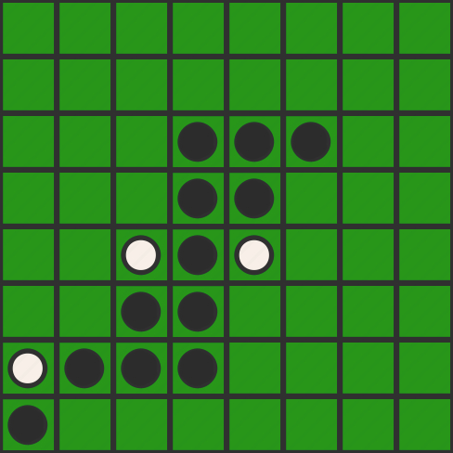
turn: 11 player: Black move: 74

Slide 14
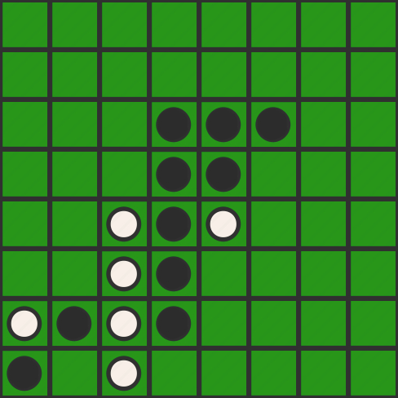
turn: 12 player: White move: 83

Slide 15
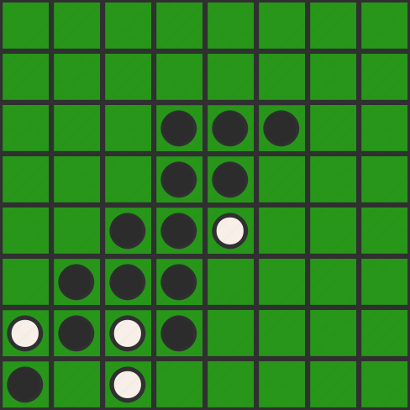
turn: 13 player: Black move: 62

Slide 16
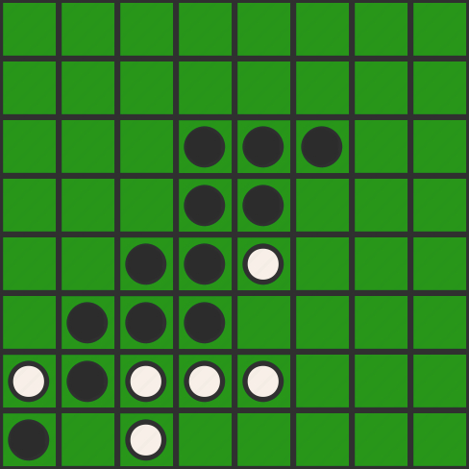
turn: 14 player: White move: 75

Slide 17
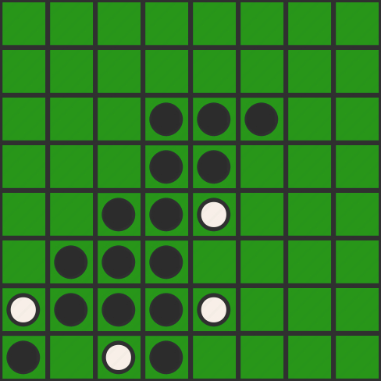
turn: 15 player: Black move: 84

Slide 18
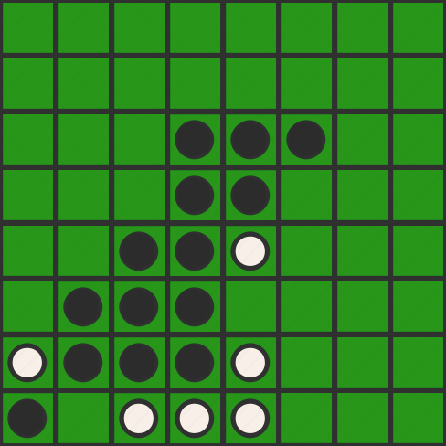
turn: 16 player: White move: 85

Slide 19
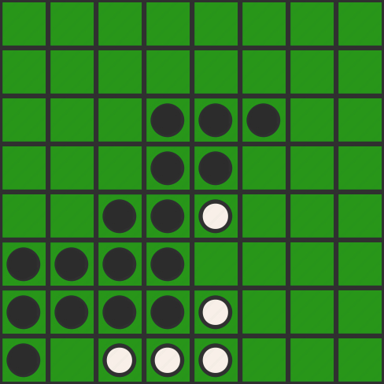
turn: 17 player: Black move: 61

Slide 20
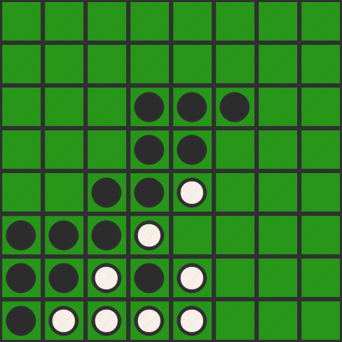
turn: 18 player: White move: 82

Slide 21
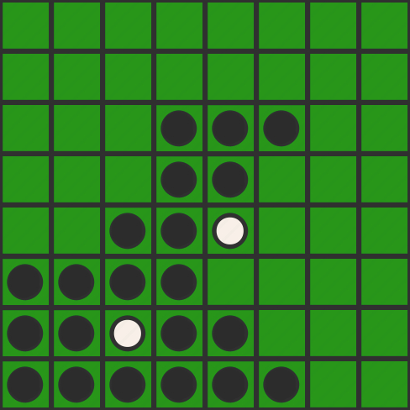
turn: 19 player: Black move: 86

Slide 22
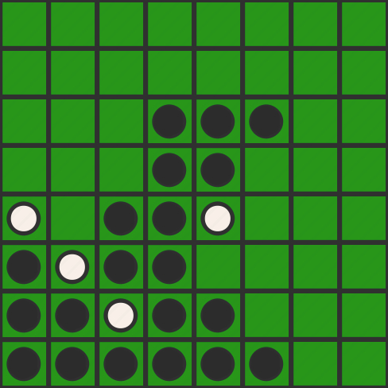
turn: 20 player: White move: 51

Slide 23
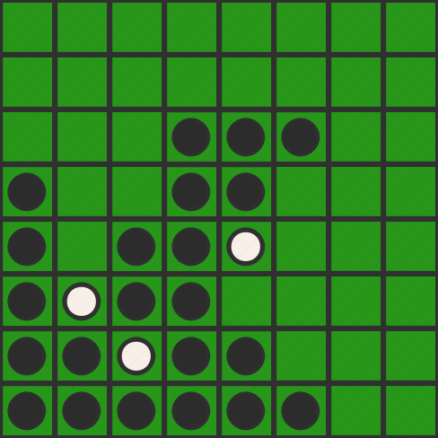
turn: 21 player: Black move: 41

Slide 24
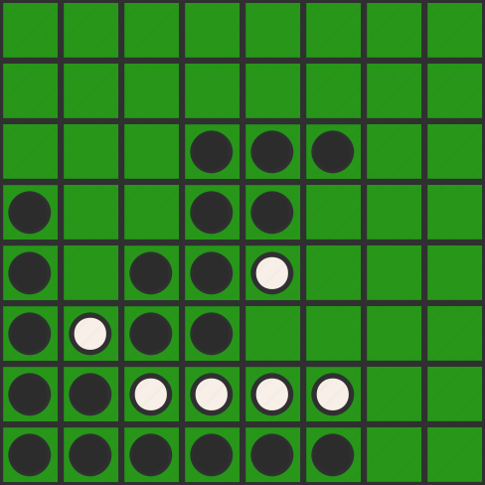
turn: 22 player: White move: 76

Slide 25
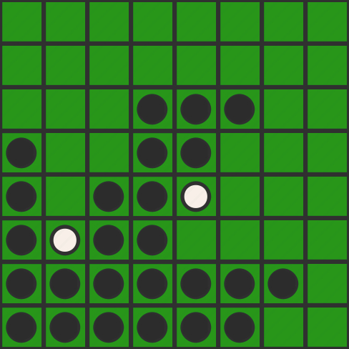
turn: 23 player: Black move: 77

Slide 26
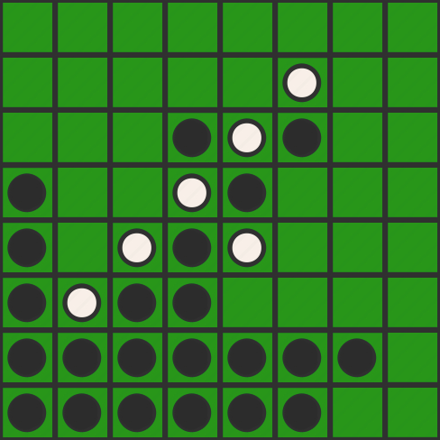
turn: 24 player: White move: 26

Slide 27
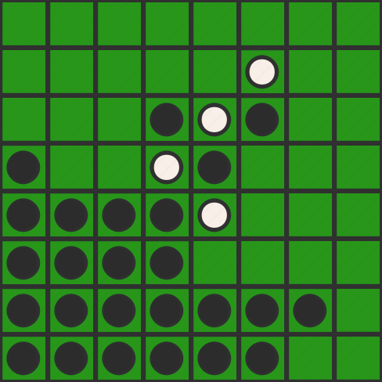
turn: 25 player: Black move: 52

Slide 28
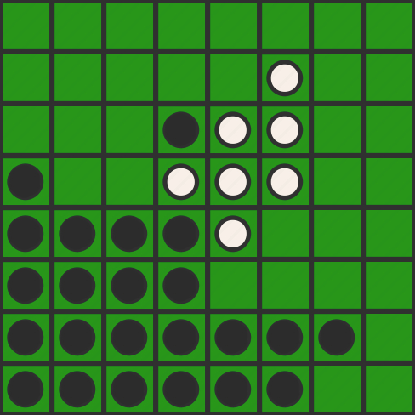
turn: 26 player: White move: 46

Slide 29
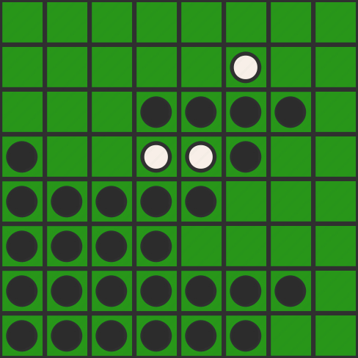
turn: 27 player: Black move: 37

Slide 30
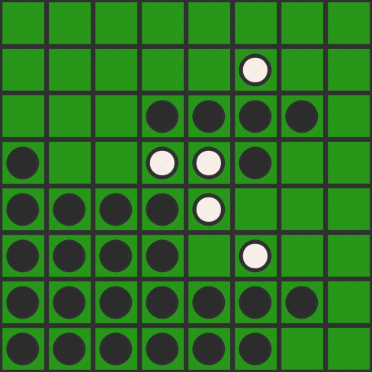
turn: 28 player: White move: 66

Slide 31
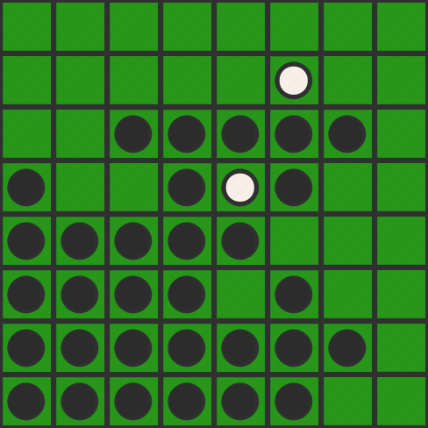
turn: 29 player: Black move: 33

Slide 32
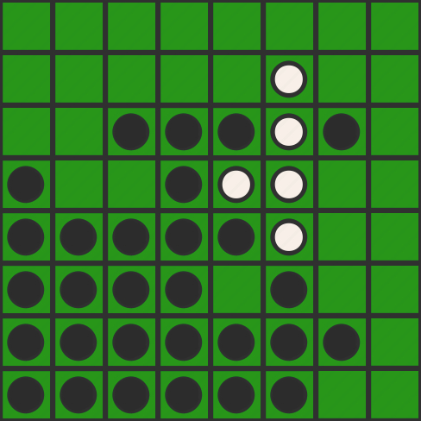
turn: 30 player: White move: 56

Slide 33
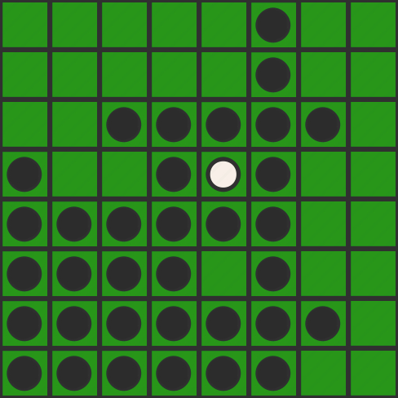
turn: 31 player: Black move: 16

Slide 34
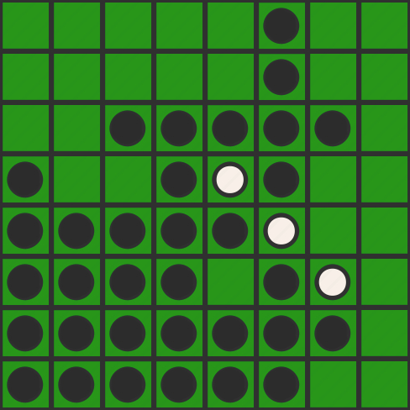
turn: 32 player: White move: 67

Slide 35
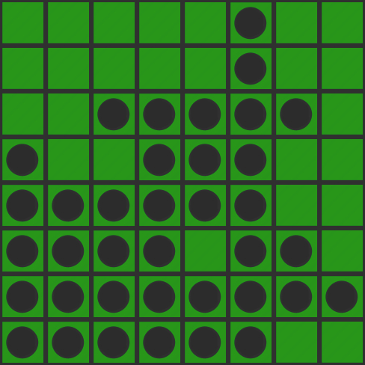
turn: 33 player: Black move: 78

Slide 36
turn: 34 player: White move: None

